Slide 1
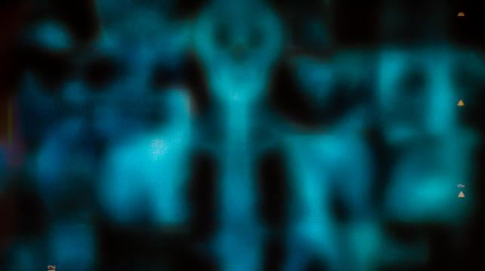
Boundary Detection
Sobel vs. Canny
A Comparative Study on Medical X-Ray Boundary Detection
Jandhyala Aditya Tarun (010189)
Vanam Divesh Reddy (010247)
Rani Yadav (010308)

Slide 2

ABSTRACT & LITERATURE REVIEW
Objective: Compare Sobel and Canny edge detectors on chest X-rays.
Problem: Medical X-rays present low contrast, noise, and overlapping anatomical structures.
Finding: Canny yields 1-pixel edges (1.87% density), and Sobel detects broader gradients (9.48% density)
Sobel (1st-Order Gradient):
Uses 3x3 kernels to measure intensity changes.
Pros & Cons: it is fast and computationally simple and highly sensitive to noise with thick edges.
Canny (Multi Stage Optimal Detector):
Applies Gaussian smoothing, non maximum suppression, and hysteresis thresholding.
Pros & Cons: it has high noise immunity and clean 1-pixel contours but may drop weak soft edges.

Slide 3
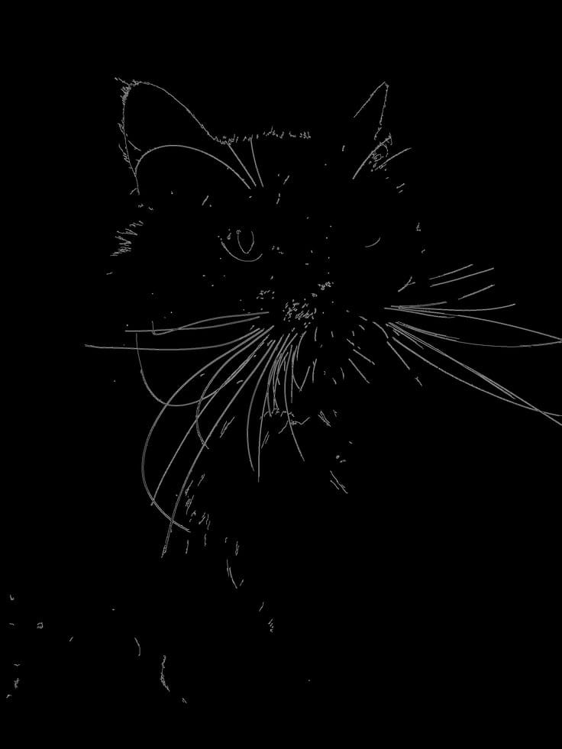
METHODOLOGY
Dataset: 100 chest X-rays (50 Normal, 50 Pneumonia) from Kaggle.
Preprocessing: Standardized to 512x512 grayscale image + 5x5 Gaussian blur where sigma = 0
Sobel Setup: 3x3 gradient magnitude kernels (Gx, Gy) with binary threshold T = 50
Canny Setup: Dual threshold hysteresis where T1 = 50, T2 = 150 with non maximum suppression
Metrics: Edge Density (%) edge pixels / total pixels and Execution Time (ms).

Slide 4
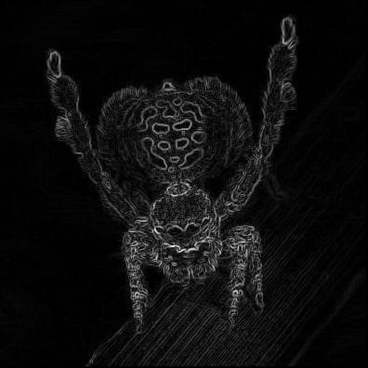
RESULTS & CONCLUSIONS
Canny is Superior for Segmentation: it provides clean 1-pixel contours and effectively suppresses uniform soft noise.
Sobel Captures Soft Gradients: it is useful for fast gradient magnitude estimation, but it produces thick, unrefined edges requiring thinning.
Clinical Application: Canny is the ideal preprocessing step for automated medical image analysis and lung boundary extraction.
Metric | Sobel | Canny
Avg. speed | 2.23ms | 0.99ms
Avg. Density | 9.48% | 1.87%

Slide 5

REFERENCES:
Canny, J. (1986). A Computational Approach to Edge Detection. IEEE Transactions on Pattern Analysis and Machine Intelligence, 8(6), 679–698.
Sobel, I., & Feldman, G. (1968). A 3x3 Isotropic Gradient Operator for Image Processing. Stanford Artificial Intelligence Project.
Mooney, P. (2018). Chest X-Ray Images (Pneumonia) Dataset. Kaggle.

